Slide 1

Penn National Gaming (PENN)
December 6, 2020

Slide 2
Company Overview

Slide 3
Company Overview
Company Highlights
Valuation & Share Performance
Penn National Gaming, Inc. owns and manages gaming and racing properties, video gaming terminal operations, and offers live sports betting
The company operates an interactive gaming (iGaming) division, which recently launched iCasino, an online casino
Purchased 36% of Barstool Sports, Inc., a leading platform for digital sports, media and entertainment. Through the deal, it became Barstool Sports’ exclusive partner for up to 40 years.
Ticker | PENN
Stock Price | $67.17
Market Cap | 10.43B
Enterprise Value | 10.75B
52-Week H/L | $76.62/$3.75
Dividend Yield | 0%
P/S | 2.23
Revenue Segmentation
Stock Performance Relative to S&P 500

Slide 4
Management
Senior Management
Management Compensation
Jay Snowden – President and Chief Executive Officer
Prior to joining Penn National Gaming, was the Senior Vice President and General Manager of Caesars and Harrah’s in Atlantic City, New Jersey
Joined the company in October 2011 as Senior Vice President-Regional Operations
Became Chief Operating Officer in January 2014
Became President and Chief Executive Officer in January 2020
Todd George – Executive Vice President-Operations
Held various management roles in the gambling industry throughout his career
General Manager at Hollywood Casino Corp since 2012
Joined Penn National Gaming in 2018 as Senior VP – Regional Operations
David Williams – Chief Financial Officer & Executive Vice President
Previously held the position of VP - Finance & Corp. Controller at Filemaker Inc.
Joined Penn National Gaming in March 2020
Compensation Structure
Base Salary: Benchmarked against 50th percentile of the base executive salaries within the industry peers.
Short-Term Incentive: To ensure achievement of carefully crafted short-term operational objectives. Provides cash incentive compensation based on company’s achievement of adjusted EBITDA targets.
Long-Term Incentive: Awards equity compensation to help align executives’ interests with those of the shareholders. Motivates executives to strive for the long-term appreciation of shareholder value.

Slide 5
Industry Analysis

Slide 6
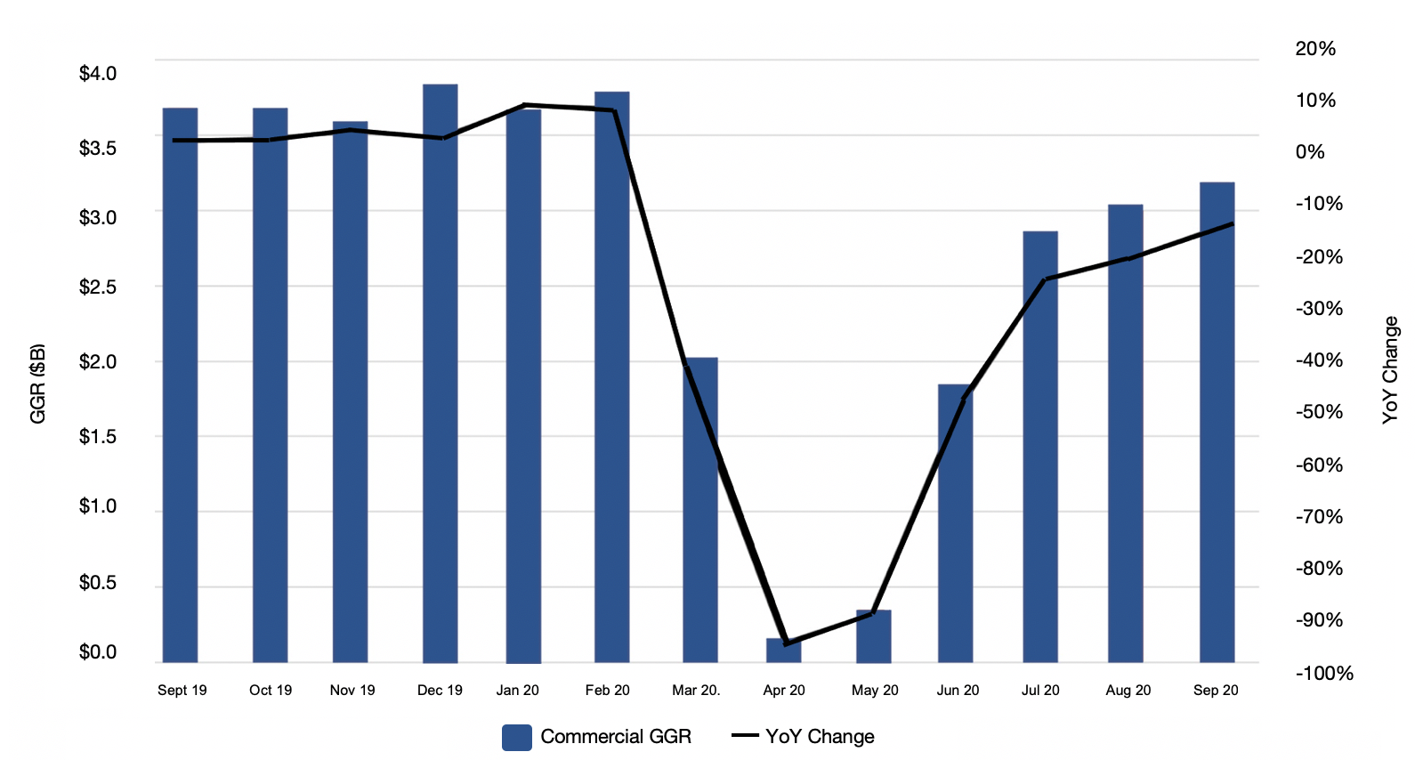
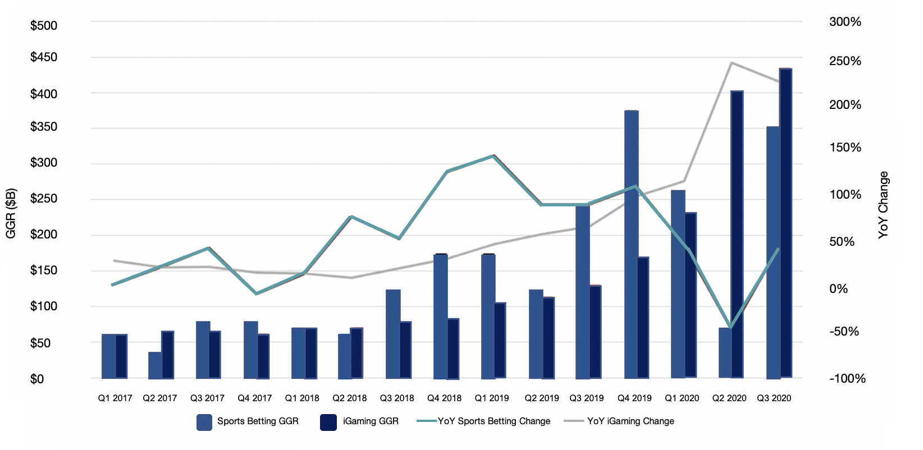
Brick-and-Mortar Casinos and iCasino
Brick-and-Mortar Casino
iCasino
Casinos suffered in Q2 of 2020 when they were shut down across the country
Casino revenue was $9 billion in Q3 2020, up +294% from Q2
Global gambling reached $449.3 billion in 2018, expected to grow at a CAGR of 5.9% to nearly $565.4 billion by 2022
Market size and value have grown from $53.7 billion in 2019 to expected $59.6 billion by end of 2020
Maintaining a CAGR of 11.5%, expected to reach $127.3 billion in 2027
Increase in 43% of daily online poker players
Increase of 255% first-time poker players compared to an average day – pre COVID-19
U.S. Gross Gaming Revenue
Sports Betting and iGaming Growth

Slide 7
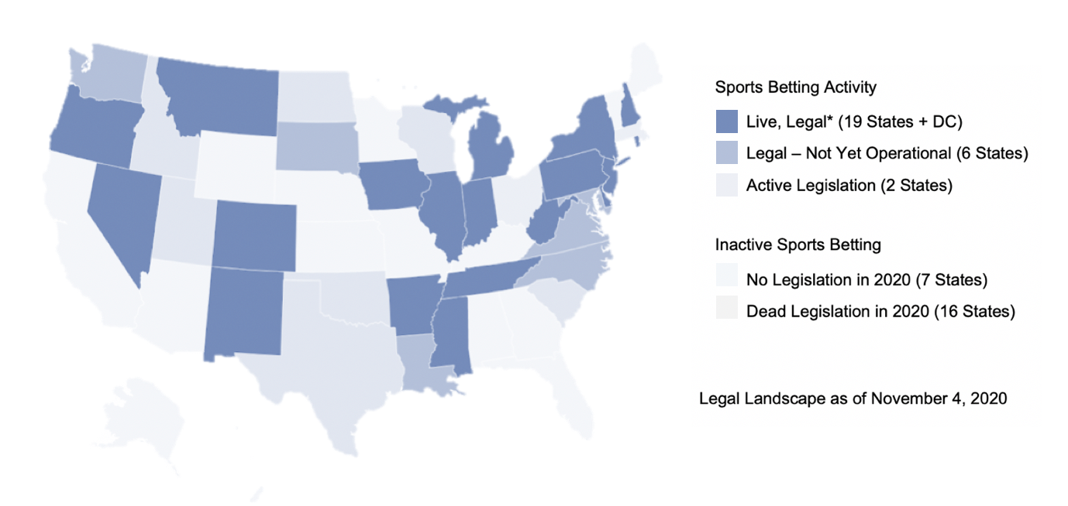
Sports Betting Market Outlook
Sports Betting Legalization Across U.S.
Legalization across the U.S. will have a positive impact on market growth
Estimated to grow to $144.44 billion through 2020-2024, CAGR of 11% during the forecast period
Driving force of growth will be the increase in commercialization of sporting events
According to KPMG, the entire global sports market is estimated to be worth between $600-700 billion and its growth over values the GDP growth of some developing countries
Sports Betting Legalization Across U.S.
U.S. Online Gambling Market Size ($B)
7

Slide 8
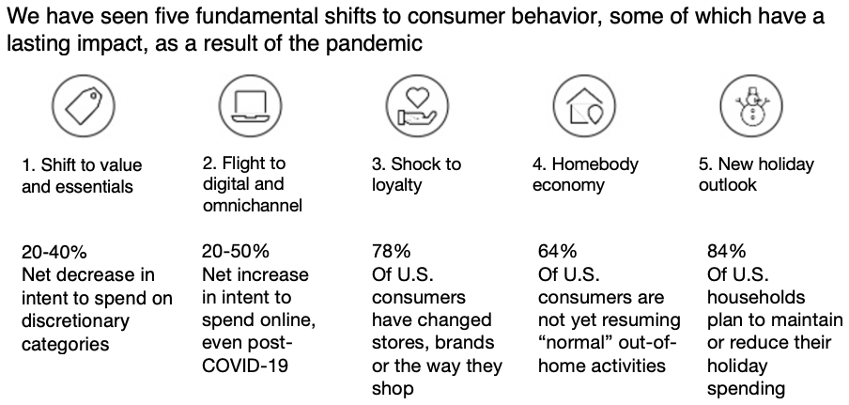
Consumer Demographics
Consumer Discretionary sector tends to underperform in times of economic uncertainty
As a result of the pandemic the unemployment rate rose to around 11.1% in June 2020 and was at 6.9% in October
According to McKinsey and Company, about 75% of the $8.5 billion in 2030 will have both mobile and Internet access
Social media is important, research from McKinsey and Company shows social media has a strong influence on purchase decisions: across product categories, on average 26% of purchases were triggered through social media
U.S. Consumer Confidence Index
Consumer Behaviour Trends
8

Slide 9
Competitive Positioning
Sports Betting
Casinos
Major competitors: DraftKings, FanDuel
Predicted to become market leader with 33% market share in future years
Large growth potential as a result from deal with Barstool
Reach of 48% of millennial and Gen X men
Launched the Barstool Sportsbook app, released in Pennsylvania, topped the app store
Plans to launch the app in all states where sports betting is legal by 2021
The app had 24,000 downloads / day in its debut weekend
Major Competitors: Boyd, Caesars Entertainment
Has the most momentum in the industry right now with a market cap of now USD 11.2 billion
First major gaming company to launch a REIT, providing more operating leverage
Current geography: 43 operating facilities in the U.S.
Regional casinos can be predicted to bounce back from COVID-19 fast due to their performance after great recession
Retail Sports Betting Handle by Age
2008 Recession Recovery
9

Slide 10
Investment Thesis

Slide 11
Investment Thesis I – Barstool Sports
Penn has better positioned itself with Barstool Sports
Barstool Audience Demographics
Acquiring Barstool Sports (BSS) has enabled Penn to attract a new young loyal betting audience for reduced customer acquisition costs
Deal structure keeps Barstool incentivized to promote the Penn ecosystem and integrate content into products
Barstool continues to grow at an exponential rate with 66 million monthly unique visitors across all their platforms
Growing Faster than Media Peers
Diversified Revenue Mix

Slide 12


Investment Thesis I – Barstool Sports
Revenue Drivers
Strong sports brand
Large sports betting demographic
In-house product development
Large retail sportsbook footprint
Leader in social/digital media
Profitability Drivers
Lower marketing costs due to media partner
Multiple states with direct market access
Recurring revenue from skin partnerships

Slide 13
Investment Thesis I – Barstool Sports
Barstool Sportsbook Success
48K Registrations in PA
30K First Time PA Depositors represents average deposit size of $243
The Barstool Sportsbook has shown strong numbers since its launch in Pennsylvania, positioning itself 3rd in market share
Barstool has geared content and promotions towards the Sportsbook to provide users increased incentives and inclusivity
Executives strongly believe they will be at minimum 3rd in market share in states where they offer the Barstool Sportsbook
$78M Total Handle 22% of picks promoted by Barstool
310K App Downloads in U.S. 95% of registrations new to Penn ecosystem
Monthly Performance ($ in Millions)
4.9 Average Rating on App Store
$0 External Marketing Spend on launch of Barstool Sportsbook

Slide 14
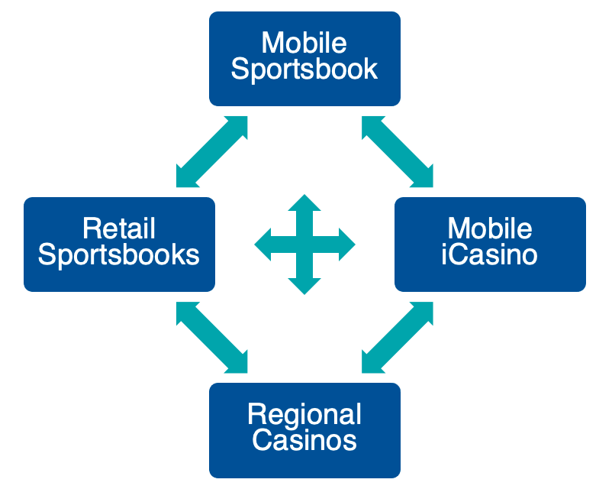
Investment Thesis II – Omni-Channel Strategy
A more diversified revenue breakdown
Early Evidence of Cross Selling
Each channel feeds off each other, providing the customer more choice
Penn can cross-sell to its 20 million mychoice members and Barstool’s 66 million “Stoolies”, resulting to greater market share
Penn has the greatest market access (in 19 states) compared to its peers, reducing market access costs
mychoice membership is designed to incentivize its members to use all its gaming products
More Channels, Greater Value
Penn’s Omni-Channel Platform
Retail Sports Only
iCasino Only
Casino Only
Casino & iCasino
Casino & Retail Sports
Casino, iCasino & Retail Sports
0.6x
0.6x
Base
4.8x
5.0x
12.6x

Slide 15
Valuation

Slide 16
Comparables Table
Company | Ticker | Share Price ($USD) | Market Cap ($M) | EV ($M) | P/S | EV/EBITDA 2021E | Debt / Equity | Revenue Growth YoY
Penn National Gaming Inc | PENN | 72.38 | 11,242 | 20,664 | 2.3x | 12.8x | 4.3 | 47.8%
Boyd Gaming Corp | BYD | 39.40 | 4,395 | 8,819 | 1.9x | 9.1x | 4.8 | 26.6%
Flutter Entertainment Plc | FLTR | 178.08 | 27,604 | 31,535 | 4.6x | 20.4x | 0.3 | 14.2%
Churchill Downs Inc | CHDN | 185.22 | 7,308 | 8,854 | 7.0x | 15.0x | 5.8 | 31.8%
Caesars Entertainment Inc | CZR | 69.37 | 14,448 | 28,700 | 2.9x | 11.8x | 4.5 | 23.0%
Bally's Corp | BALY | 47.51 | 1,448 | 2,328 | 3.9x | 10.3x | 6.4 | 19.7%
Bear (First Quartile) |  | 47.51 | 4,395 | 8,819 | 2.9x | 10.3x | 4.5 | 19.7%
Base (Median) |  | 69.37 | 7,308 | 8,854 | 3.9x | 11.8x | 4.8 | 23.0%
Bull (Third Quartile) |  | 178.08 | 14,448 | 28,700 | 4.6x | 15.0x | 5.8 | 26.6%
EV / EBITDA
 | Bear | Base | Bull
EBITDA 2021E | 1,632 | 1,632 | 1,632
EV/EBITDA 2021E | 10.3x | 11.8x | 15.0x
Enterprise Value | 16,742 | 19,239 | 24,477
Less: Debt | (11,274) | (11,274) | (11,274)
Add: Cash | 1,873 | 1,873 | 1,873
Equity Value | 7,341 | 9,838 | 15,076
Shares Outstanding | 155.3 | 155.3 | 155.3
Equity Value per Share | $47.29 | $63.37 | $97.11
Market Premium to Fair Value | (35%) | (12%) | 34%
EV/EBITDA Distribution

Slide 17
Discounted Cash Flow
Free Cash Flow | 2015A | 2016A | 2017A | 2018A | 2019A | 2020E | 2021E | 2022E | 2023E | 2024E
12 Months Ending | 12/31/2015 | 12/31/2016 | 12/31/2017 | 12/31/2018 | 12/31/2019 | 12/31/2020 | 12/31/2021 | 12/31/2022 | 12/31/2023 | 12/31/2024
EBITDA | 727.3 | 814.2 | 712.8 | 903.1 | 986.1 | 29.4 | 1,603.2 | 2,065.2 | 2,497.8 | 2,919.3
EBIT | 467.8 | 543.0 | 445.7 | 634.1 | 571.9 | (244.0) | 1,232.3 | 1,632.3 | 2,011.2 | 2,382.3
EBIAT (NOPAT) | 5.7 | 492.1 | (8,426.3) | 659.4 | 286.3 | (291.8) | 911.9 | 1,207.9 | 1,488.3 | 1,762.9
Add: Depreciation and Amortization |  |  |  |  |  | 273.4 | 370.9 | 432.9 | 486.5 | 537.1
Add: Stock-Based Compensation |  |  |  |  |  | 11.9 | 11.1 | 12.3 | 13.2 | 14.1
Add: Changes in Net Working Capital |  |  |  |  |  | (11.9) | (23.0) | (15.7) | (13.9) | (13.3)
Unlevered CFO |  |  |  |  |  | (18.4) | 1,270.9 | 1,637.4 | 1,974.1 | 2,300.8
Less: Capital Expenditures |  |  |  |  |  | (115.3) | (156.5) | (182.6) | (205.3) | (226.6)
Less: Purchases of Intangible Assets |  |  |  |  |  | 0.0 | 0.0 | 0.0 | 0.0 | 0.0
Unlevered FCF |  |  |  |  |  | (133.7) | 1,114.4 | 1,454.7 | 1,768.9 | 2,074.2
PV of Unlevered FCF |  |  |  |  |  | (132.3) | 987.3 | 1,154.4 | 1,257.3 | 1,320.6
Assumptions | 2021E | 2022E | 2023E | 2024E
 | 12/31/2021 | 12/31/2022 | 12/31/2023 | 12/31/2024
Sports Betting/iCasino Market Share
Bear Case | 11.0% | 11.0% | 11.0% | 11.0%
Base Case | 12.0% | 12.0% | 12.0% | 12.0%
Bull Case | 13.0% | 13.0% | 13.0% | 13.0%
Gaming Growth Rate
Bear Case | 8.8% | 6.4% | 3.4% | 2.3%
Base Case | 9.8% | 7.4% | 4.4% | 3.3%
Bull Case | 10.8% | 8.4% | 5.4% | 4.3%

Slide 18
Discounted Cash Flow
Perpetuity Approach
FCF in Last Forecast Period | 2,074.2
FCF t+1 | 2,115.7
Long-Term Growth Rate | 2.0%
Terminal Value | 21,946.2
Present Value of Terminal Value | 13,973.2
Present Value of Stage 1 Cash Flows | 4,587.4
Enterprise Value | 18,560.5
Exit EBITDA Multiple Approach
Terminal Year EBITDA | 2,919.3
Terminal Value EBITDA Multiple | 12.2x
Terminal Value | 35,586.8
Present Value of Terminal Value | 22,658.1
Present Value of Stage 1 Cash Flows | 4,587.4
Enterprise Value | 27,245.5
WACC
Cost of Debt | 5.6%
Tax Rate | 26.0%
After-Tax Cost of Debt | 4.2%
Risk-Free Rate | 0.8%
Beta | 2.20
Market Risk Premium | 7.7%
Cost of Equity | 17.8%
Market Value of Equity | 11,481.6
Equity Weight | 55.0%
Net Debt | 9,400.9
Debt Weight | 45.0%
WACC | 11.6%
Fair Value per Share | Perpetuity | Exit EBITDA
Enterprise Value | 18,560.5 | 27,245.5
Less: Net Debt | (9,400.9) | (9,400.9)
Equity Value | 9,159.6 | 17,844.6
Diluted Shares | 158.6 | 158.6
Equity Value per Share | $57.74 | $112.49
Market Premium (Discount) to Fair Value | (20.2%) | 55.4%

Slide 19
Risks, Mitigations and Catalysts

Slide 20
Risks, Mitigations and Catalysts
Risks
COVID-19 risk: Drastically reduced demand for casino gaming and related amenities
Laws and regulations: Different laws and continuous fluctuations regarding product standards in markets of operation
Consumer buying behaviours: Changing consumer buying behaviours may be a threat to Penn’s business model
Mitigations
Reduced operational cost structure: Penn decreased operational expenses and improved its technological capabilities to drive higher margins in the future
Active participation in laws and regulations: Penn stays actively involved in the rules and regulations pertaining to its industry of operation
Diversified operations: Diversified streams of revenue across multiple segments of online and in-person gambling
Catalysts
Progress in the legalization of sports betting: Sports betting being pushed for legalization in numerous states shows huge promise
COVID-19 vaccine: The release of an effective Covid-19 vaccine will reduce threats of casino and economy closures. May cause the easing of guidelines resulting in less strict entrant capacities. Reduce the risk of an economic downturn.

Slide 21
Recommendation

Slide 22
Recommendation
Barstool Sports
Omni-Channel Strategy
Buy
Implied Price | Implied Price
Perpetuity Approach | $57.74
Weight | 33.3%
Exit EBITDA Approach | $112.49
Weight | 33.3%
Comparables Table | 63.37
Weight | 33.3%
Weighted Price | $77.87
Market Premium (Discount) | 7.6%
Football Field

Slide 23
Appendix

Slide 24
Discounted Cash Flow – Net Debt and Dilutive Shares
Net Debt
Cash and Cash Equivalents | 1,873.1
Debt | 11,274.0
Net Debt | 9,400.9
Options/Warrants
Basic Shares Outstanding | 155.3
Exercisable Options | 4.1
Exercise Price | $13.62
In-the-Money Exercisable Options | 4.1
Total Proceeds | 55.4
Total Shares Repurchased | 0.8
Net Dilutive Options | 3.3
Dilutive Impact of Shares from Other Securities | 0.0
Net Dilutive Shares Outstanding | 158.6
 |  | Long-Term Growth Rate
 | $57.74 | 1.0% | 1.5% | 2.0% | 2.5% | 3.0%
W | 10.6% | 60.89 | 66.32 | 72.37 | 79.16 | 86.85
A | 11.1% | 54.48 | 59.30 | 64.65 | 70.62 | 77.32
C | 11.6% | 48.68 | 52.99 | 57.74 | 63.02 | 68.90
C | 12.1% | 43.41 | 47.27 | 51.52 | 56.21 | 61.41
 | 12.6% | 38.59 | 42.07 | 45.89 | 50.08 | 54.70
 |  | EBITDA Multiple
 | $112.49 | 11.2x | 11.7x | 12.2x | 12.7x | 13.2x
W | 10.6% | 106.44 | 112.52 | 118.60 | 124.68 | 130.76
A | 11.1% | 103.58 | 109.54 | 115.51 | 121.48 | 127.45
C | 11.6% | 100.77 | 106.63 | 112.49 | 118.35 | 124.21
C | 12.1% | 98.04 | 103.79 | 109.54 | 115.29 | 121.05
 | 12.6% | 95.36 | 101.01 | 106.65 | 112.30 | 117.95

Slide 25
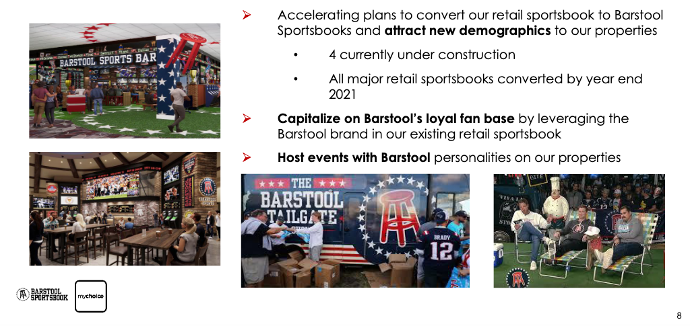
Barstool-Branded Retail Sportsbooks

Slide 26
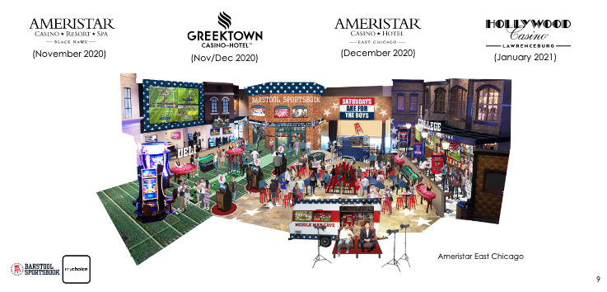
Barstool Sportsbooks in Development

Slide 27
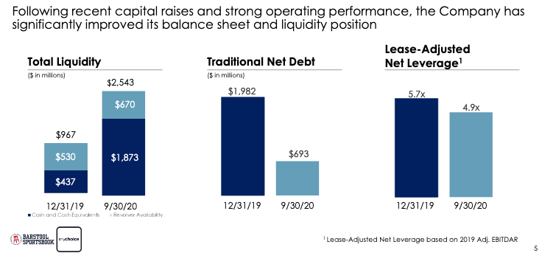
Improved Balance Sheet and Liquidity

Slide 28
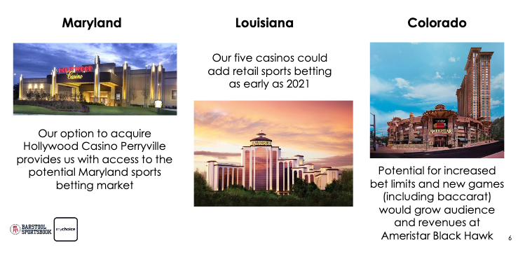
Upcoming Ballot Initiatives

